Slide 1
Data Dictionary Storage
Information about database program units can be obtained from the Data Dictionary.
The data dictionary presents database object information for a schema with views using one of the following prefixes:
The DESCRIBE and SHOW ERRORS commands provided limited formatted reports of data dictionary information.
Dictionary | Description
USER_ | Views owned by the current user
ALL_ | All objects accessible to a user regardless of schema
DBA_ | Administrator - all objects within database

Slide 2
Data Dictionary Views
View Name | Purpose
USER_OBJECTS | This lists all database objects, including program units. The OBJECT TYPE column indicates which objects are stored program units
USER_SOURCE | The actual source code is accessible using this view.
USER_ERRORS | Compilation errors that exist for the current version of the program.
USER_OBJECT_SIZE | The size of the program
USER_DEPENDENCIES | All dependent objects for each database program unit.

Slide 3
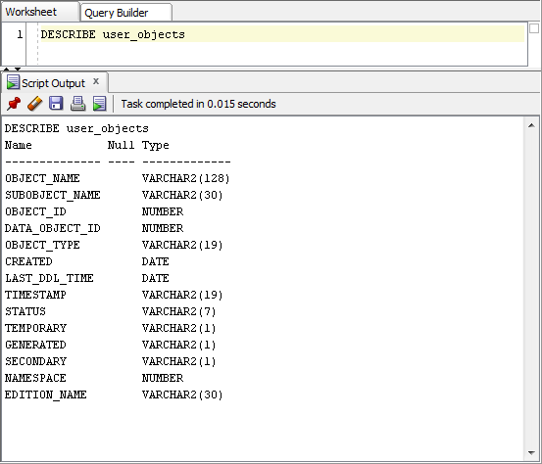
USER_OBJECTS View
The DESCRIBE View command tells Oracle to show the underlying view.
DESCRIBE user_objects

Slide 4
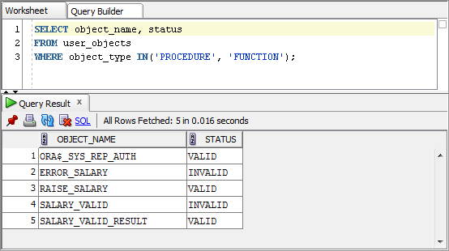
Query USER_OBJECTS
The following query, we limit the selection to stored procedures and functions.

Slide 5
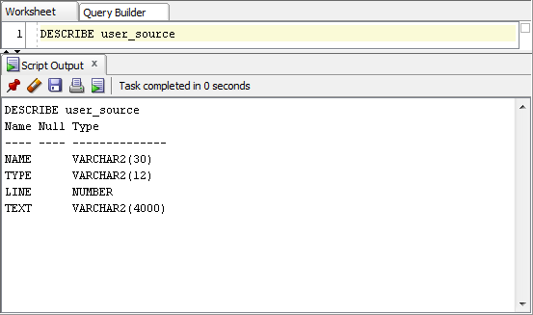
USER_SOURCE View
DESCRIBE user_source

Slide 6
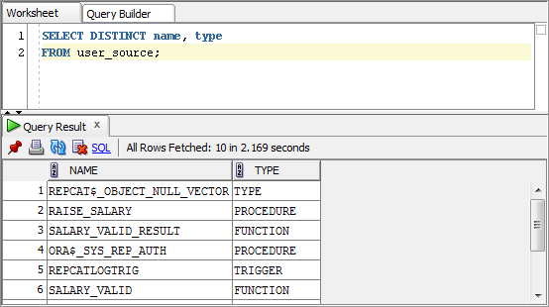
Query USER_SOURCE
The following query retrieves all objects that have source code.
The RAISE_SALARY procedure is currently stored in the database.

Slide 7
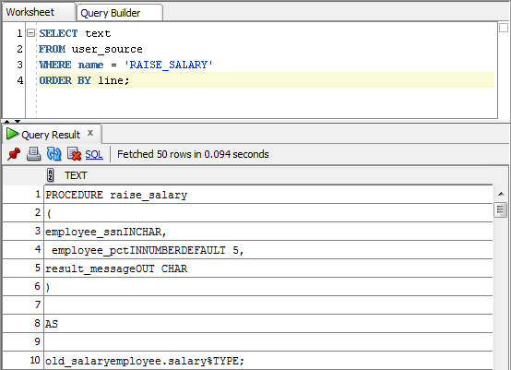
Query USER_SOURCE (cont)
Now that we know about the RAISE_SALARY procedure, we can retrieve the stored code.

Slide 8
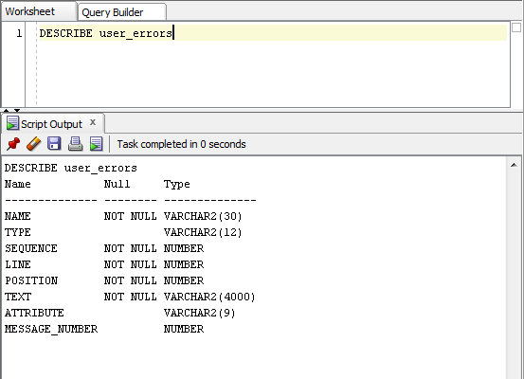
USER_ERRORS View
DESCRIBE user_errors
The ATTRIBUTE column contains the values ‘ERROR’ or ‘WARNING’ indicating the severity.

Slide 9
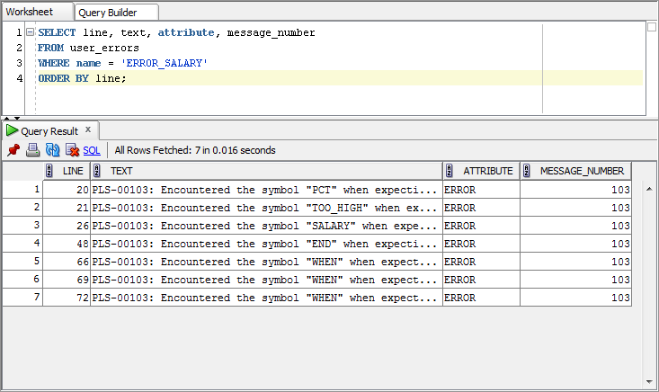
Query USER_ERRORS
We learned from our earlier query that the ERROR_SALARY procedure is invalid. We can query the view to see the errors.
SELECT line, text, attribute, message_number
FROM user_errors
WHERE name = 'ERROR_SALARY'
ORDER BY line;

Slide 10
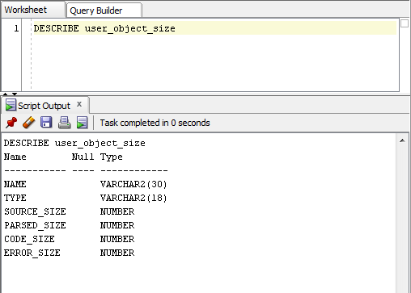
USER_OBJECT_SIZE View
The USER_OBJECT_SIZE is instrumental in planning for the storage and execution of PL/SQL applications within the database.
DESCRIBE user_object_size

Slide 11
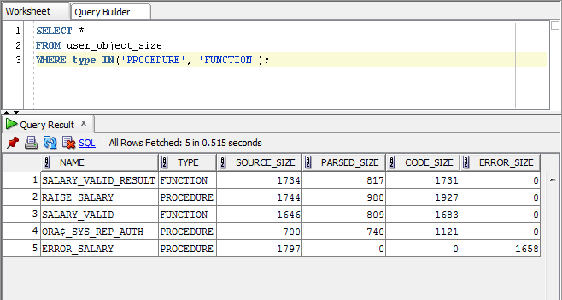
Query USER_OBJECT_SIZE
Each of the columns describe a different size parameter for the objects.

Slide 12
USER_OBJECT_SIZE Columns
Column | Explanation
SOURCE_SIZE | Indicates the size of the source code.
PARSED_SIZE | This is the parsed form of the program which is loaded into memory during compilation. The maximum size is 64K.
CODE_SIZE | This is the compiled version of the program. There is a maximum size of 128K.
ERROR_SIZE | This is the size of the error message information, if any.

Slide 13
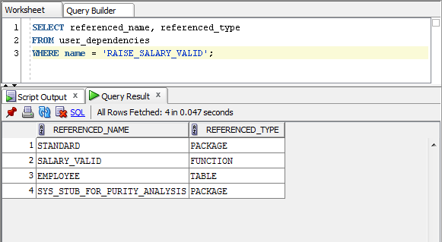
Using USER_DEPENDENCIES
This view exposes limited dependency information pertaining to program objects.
 The name is case sensitive
 This view is somewhat limited because it only reveals a single-level of direct dependencies.

Slide 14

See it in Action

